Slide 1
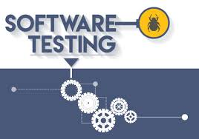
SOFTWARE TESTING

Slide 2
SOFTWARE TESTING:
Testing is the process of executing a program with intention of finding error
Software testing is the act of examining the artifacts and the behavior of the software under test by validation and verification.
Software testing can also provide an objective, independent view of the software to allow the business to appreciate and understand the risks of software implementation.
Testing is important because software bugs could be expensive or even dangerous.
The important reasons for using software testing are: cost-effective, security, product quality, and customer satisfaction.

Slide 3
BENEFITS:
Cost-Effective: It is one of the important advantages of software testing.
Security: It is the most vulnerable and sensitive benefit of software testing.
Product quality: It is an essential requirement of any software product.
Customer Satisfaction: The main aim of any product is to give satisfaction to their customers.

Slide 4
TYPES OF SOFTWARE TESTING:
Functional testing: Unit testing , integration testing.
Non-Functional Testing: performance , load, scalability, usability.
Maintenance Testing: Regression, maintenance

Slide 5
Why Software Testing is Important?
Software Testing is Important because if there are any bugs or errors in the software, it can be identified early and can be solved before delivery of the software product.
Properly tested software product ensures reliability, security and high performance which further results in time saving, cost effectiveness and customer satisfaction.

